Slide 1



AFTERMEDAI

Slide 2
Post-Discharge Care Challenges / Existing Gaps
Current post-discharge care solutions often lack structure and support, leading to patient confusion and lack of compliance with care instructions after leaving the hospital.
Unstructured Summaries
Lack of Support
Trackability Issues
Discharge summaries are typically provided as unstructured PDFs, making them difficult for patients to navigate.
Patients receive no real-time support for questions, causing misunderstandings about their post-discharge care.
Follow-up tasks remain untrackable, leaving patients and providers uncertain about care progression.

Slide 3
Proposed Solution
AfterMedAI aims to transform post-discharge care with AI technology that enhances patient understanding and compliance through tailored support and monitoring.
Problem Statement
Existing Solutions
Proposed Features
Over 40% of patients struggle with discharge instructions, leading to confusion and non-compliance.
Current discharge summaries are often unstructured, lacking real-time support for patients' questions and follow-up tasks.
AfterMedAI uses AI to convert discharge instructions into structured tasks and reminders, enabling better patient engagement and care continuity.

Slide 4
Agent Behavior
AfterMedAI enhances post-discharge care by utilizing AI to interpret discharge summaries, ensuring patients receive personalized follow-up instructions and support for better health outcomes.
Summary Extraction
Simplified Guidance
Risk Escalation
Reads discharge summaries and accurately extracts medications, tasks, and important dates for patients.
Generates easy-to-understand instructions, answering patients' questions in natural language for clarity.
Identifies high-risk cases and escalates them to healthcare providers for immediate intervention.

Slide 5

AfterMedAI System Architecture

Slide 7

Wireframes Overview

Slide 9
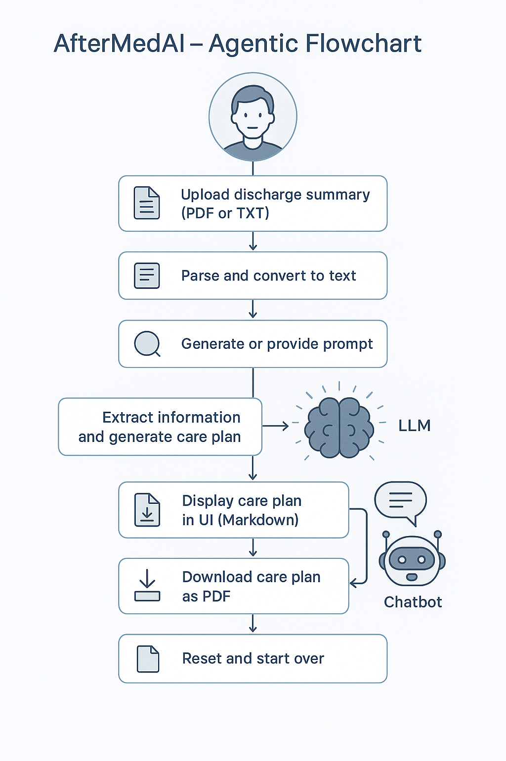
AgenticAI Flow

Slide 10
OpenAI Model
The OpenAI model serves as the backbone for AfterMedAI, enhancing post-discharge care through advanced language processing and real-time support for patients and providers.
Language Understanding
Structured Information
Seamless Integration
Advanced language comprehension enables effective extraction and summarization of essential patient information for clear communication.
The model provides structured outputs from unstructured data, ensuring patients receive personalized care instructions tailored to their needs.
OpenAI's API facilitates easy integration with existing systems, allowing for real-time deployments and improved workflow for healthcare providers.

